Slide 1

Cricket Player Management System
Prepared By:
Muhammad Mohsin
Muhammad Qasim
Muhamad Kashif
Sheryar Jamal

Slide 2
Project Introduction
Our Project is about the management of Cricket Players.
This project maintain the profile of players.
The profile tells you about the player characteristics and his performance.
Creating Profile of new player, Editing existing profile of player can be done in this project.

Slide 3
Use of OOP Concept
We have developed this project by using object oriented programming concepts.
These Concepts are implemented in our project.
Class
Objects
Inheritance (Single, Multiple)
Polymorphism

Slide 4
Classes
This project is based on 5 classes
Player
Bowler
Batsman
All-rounder
Edit

Slide 5
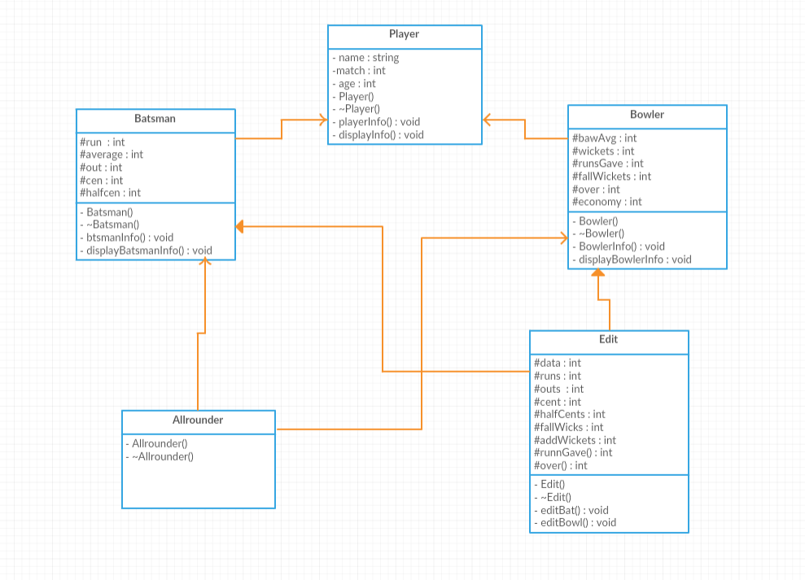
Class Diagram

Slide 6
Player Class
This class has only public members.
We have three public variables in this class which store the name, age and no of matches played by the player.
To initialize the value of variables a non parameterized constructor is used.
A Playerinfo function is used to get the basic info about player.

Slide 7
Bowler Class
This class is public virtual inherited with player class.
This class has protected member variable like no of wickets, average and economy etc.
This class also have non-parameterized constructor to initialize the protected member
This class contained one public function that is Bowler Info();
This function is responsible to get the record of the Bowler.

Slide 8
Batsman Class
This class is public virtual Inherited with Player class.
This class has protected member variable like run, average and no of centuries etc.
This class also have non-parameterized constructor to initialize the protected member
This class contained one public function that is Batsman Info();
This function is responsible to get the record of the Batsman.

Slide 9
All-Rounder Class
This class is multi public inherited with Batsman and Bowler class.
Because of public Inheritance all the public and protected member of Batsman and Bowler class will transfer into All-rounder public and protected member

Slide 10
Edit Class
Edit class is multi pubic Inherited with Batsman and Bowler class.
As the player play matches and his record have to be changed so for this purpose we have make this class.
This class contained two public function that are:
Edit Bat(); (for editing the batsman record)
Edit Bowl(); (for editing the bowler record)

Slide 11
Thankyou ☺

